Slide 1
Paper: SemEval-2019 (OffensEval): Identifying and Categorizing Offensive Language in Social Media
Author: Nikhil Oswal
Institution: School of Electrical Engineering and Computer Science (EECS), University of Ottawa, Ottawa, Canada
Presented By:
Sheikh Ayatur Rahman - 20201083
Sabiha Tahseen - 17101527
Albert Boateng - 20216003

Slide 2
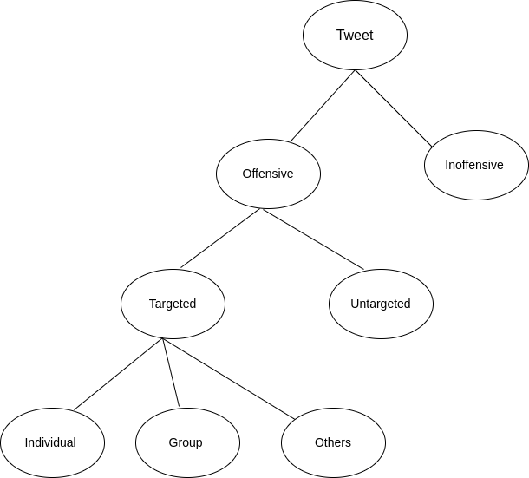
INTRODUCTION
The study focuses on the identification and categorization of offensive language on social media.
It focuses on three subtasks namely offensive language detection, categorization of offensive language and offensive language target identification.
Sub Task A aims to detect text as offensive or not offensive.
Sub Task B aims to categorize the offensive type as targeted text or untargeted text.
Sub Task C focuses on the identification of target as individual, group or others.

Slide 3
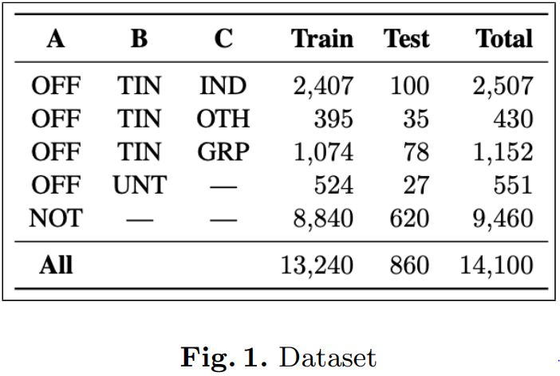
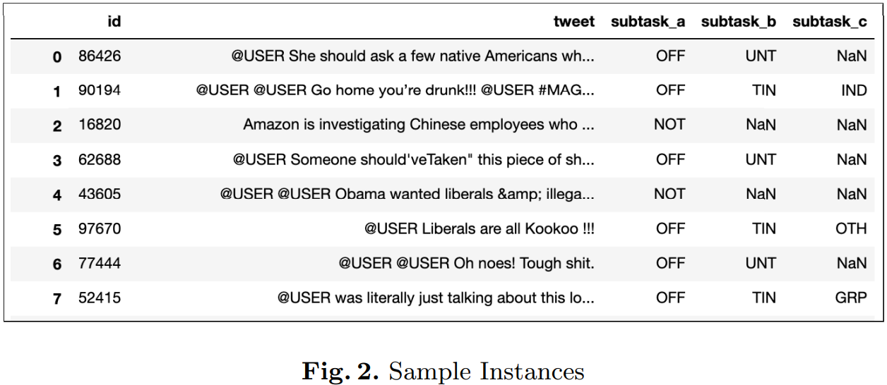
2. CASE STUDY
Task Description:
Sub-task A - Offensive language identification
Sub-task B - Automatic categorization of offense types
Sub-task C - Offense target identification
Dataset
The dataset comprised of 14,100 annotated tweets divided into a training partition of 13,240 tweets and a testing partition of 860.

Slide 4
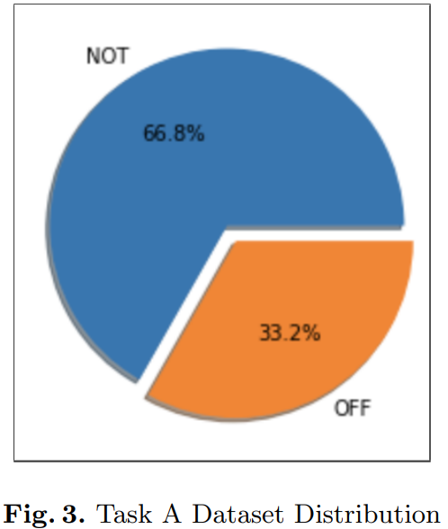
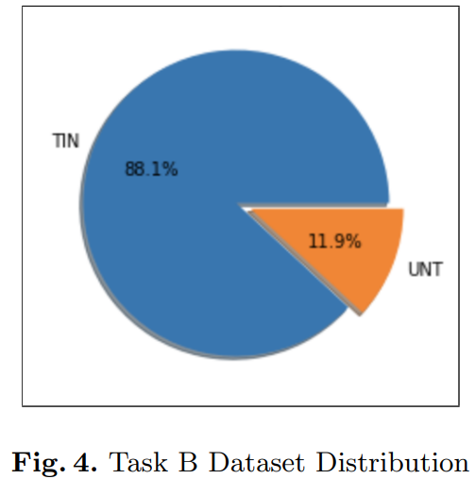
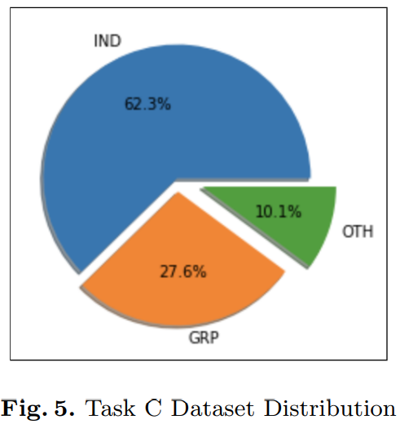
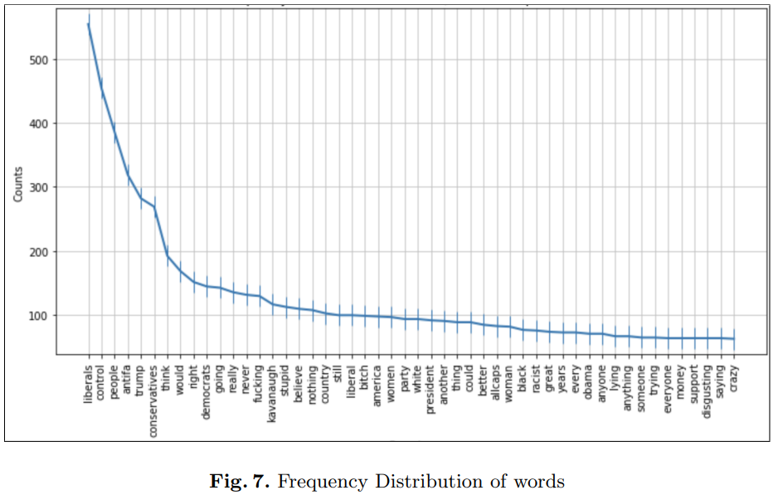
3. METHODOLOGY
Data Exploration and Analysis
Data Preprocessing
- Twitter Specific
- Emojis
- Special Characters
- Tokenization
Feature Extraction
- TF-IDF / Count
- Word Embedding
Model
- Naive Bayes
- Support Vector Machine
- Random Forest
- LSTM
Evaluation
- Accuracy
- Precision
- Recall
- F1-Score
- Confusion Matrix

Slide 5
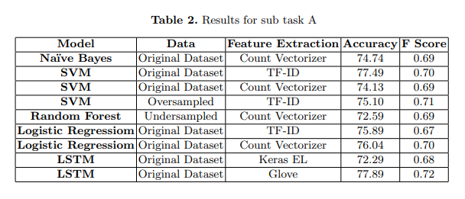
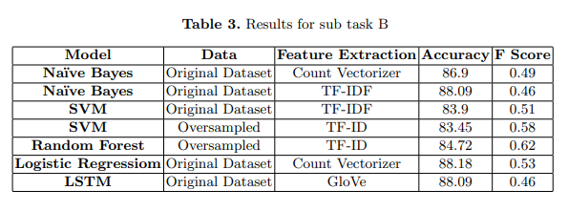
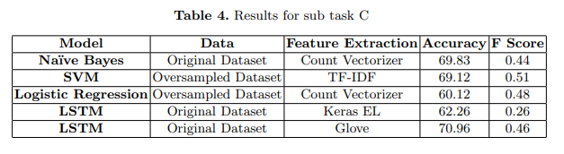
4. Experimentation
Environment: Python3 and Jupyter Notebook
Performance on each of the three tasks varied with respect to model chosen, feature method, and sampling technique used
Best Models:
Sub-task A: LSTM
Sub-task B: Random Forest
Sub-task C: SVM

Slide 6
5. Conclusion and Further Thoughts
The paper notes that the best performing models in the competition used state of the art architecture like BERT
The OLID dataset will be expanded in the future
Keeping punctuations and stop words may have improved performance.
Exclamation mark may have been more common in offensive words
Class imbalance in the dataset needs to be addressed.

Slide 7
Thank You For Viewing Our Presentation

